Slide 1
Effective delivery of infrastructure projects
Seminario sobre Gobernanza en conmemoración del 20 aniversario del Centro OCDE para México y América Latina
17 noviembre 2016
Matthieu CAHEN, Policy Analyst

Slide 2
Infrastructure matters
Infrastructure investments are expected to provide tangible impacts on growth, quality of life and productivity.
Total global infrastructure investment requirements by 2030 will come to USD 71tn (3.5% of the annual World GDP from 2007 to 2030).
A large share of infrastructure investment are and will be borne by governments
Notes:
According to an IMF report on investment shocks in infrastructure (2014) an unanticipated 1 percentage point of GDP increase in investment spending increases the level of output by about 0.4 percent in the same year and by 1.5 percent four years after the shock.

Slide 3
Yet, projects are increasingly complex
Interconnected layers in governance structure
Strategic choices on infrastructure projects ownership and delivery modes
Project developments require responsive policy making

Slide 4
If not strategically managed, projects may falter
The “four Cs” in infrastructure projects:
Inadequate Cost recovery
Corruption
Insufficient Competition
Low Credibility of institutions.

Slide 5
Towards effective delivery of infrastructure projects
Among other tools developed by the OECD, two major instruments can contribute to address the “four Cs”:
The Recommendation of the Council on Public Procurement
The Integrity Framework for Public Investment

Slide 6
Implementing strategic procurement
Government procurement as share of GDP and of total govt. expenditures
Source: OECD National Accounts Statistics. (2013)
Being the connecting dot between the public and the private sector, a strategic procurement system is crucial to the effective delivery of infrastructure projects.

Slide 7
The 2015 Recommendation on Public Procurement: 12 integrated principles
Transparency
Accountability
Access
Participation
E-Procurement
Efficiency
Evaluation
Integration
Capacity
Integrity
Balance
Risk Management
Notes:
Efficiency, Integrity and Transparency fuel all these integrated principles summarising OECD best practices in public procurement. They apply to all delivery models of infrastructure.

Slide 8
Developing a whole-of-project integrity system
Infrastructure projects are prone to integrity risks because of their magnitude
TI, the OECD and the American Society of Civil Engineers estimate the costs of corruption between 10% and 30 % of investment
Given their complexity, infrastructure projects owners should go beyond abiding by existing laws and regulations
Notes:
The infrastructure sector is particularly vulnerable to corruption and undue influence due to the extent of public officials’ discretion over the investment decision, the multiple stages and the large sums of money and stakeholders involved, including elected and non-elected public officials, lobbyists, civil society organisations, trade unions, regulators, contractors, consultants, engineers and suppliers.
According to COST, annual losses in global construction through mismanagement, inefficiency and corruption could reach USD 2.5 trillion by 2020.

Slide 9
OECD Integrity Framework for Public Investment: addressing the entire cycle
The Framework proposes measures safeguarding integrity at each phase of the investment cycle:
Selection phase: making investment decisions in the public interest
Appraisal phase: ensuring credible and objective estimations of all costs and benefits related to the project
Planning phase: ensuring tender documents and processes do not unduly favour some stakeholders
Tendering phase: ensuring processes that promote qualification, accountability and value for money
Implementation phase: minimizing delays for completion, excess costs, and ensuring quality
Evaluation phase: auditing the government project upon completion by an independent institution

Slide 10
Countries’ experience in the governance of infrastructures
In 2016, the OECD issued a survey on the governance of infrastructures:
Questionnaire responded by 26 OECD members and key partners
“Good practices” can be found in a majority of countries
No country is a “best practice”

Slide 11
Main findings
Coordination across levels of governments is common in countries with long term strategic plans. However, intergovernmental coordination mechanisms for infrastructure are not frequent.
The most relevant criteria for determining the delivery modality are financial criteria, such as public sector financial resources, availability of public sector capacity, cost recovery possible from users, as well as the outcome of a quantitative analysis.
Governance throughout the infrastructure lifecycle needs to be improved. Most institutions are responsible for the development of infrastructure policy and the improvement of infrastructure performance. Responsibilities for the assessment and monitoring of the projects are less defined.

Slide 12
Key Factors for effective delivery of infrastructures

Slide 13
Creating the right environment
An infrastructure environment conducive to effective delivery of projects starts with a skilled and mature organisation, notably for the procurement workforce.
Organisational capacity is a prerequisite for public procurement.

Slide 14
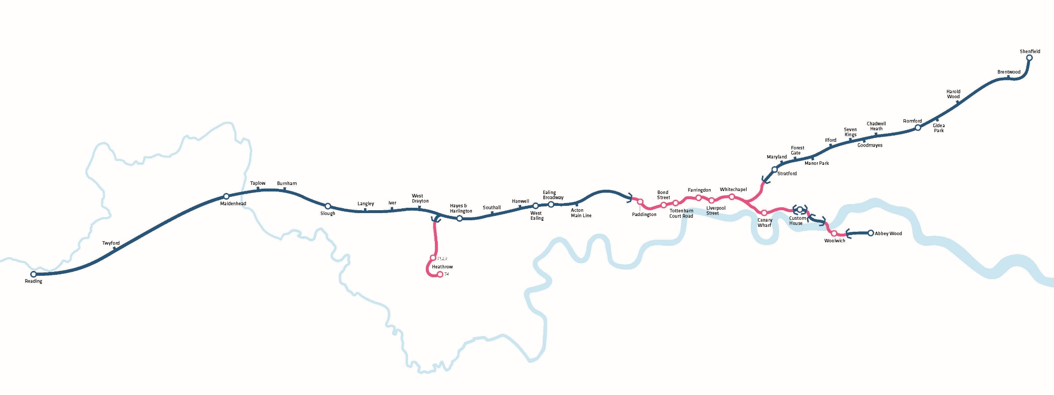
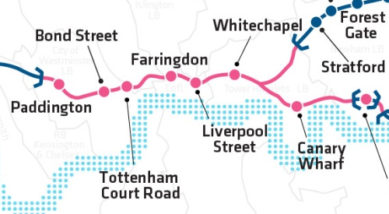
Capacity tests The example of Crossrail
Source: Crossrail
Notes:
Crossrail is one of the largest EU infrastructure projects (more than USD 20 bn in construction cost). 42 km of tunnels being currently constructed under central London (red line new tunnels, blue is upgraded railway and stations).
To manage construction a project company (Crossrail Ltd) has been created but the full procurement authority has only been delegated by the central government nearly 3 years after its inception. It was first required to prove, at an number of Review Points (gateways), that it had the processes and controls in place, with sufficient, skilled staff to control the procurement risk.

Slide 15
Engaging Stakeholders - Consultations
Mandatory consultation processes are used at all stage of the infrastructure governance process
In more than half of the countries, consultation is also mandatory for the evaluation of infrastructural needs and for the decision process of prioritising infrastructure projects.
During the construction phase, mandatory consultation is less common.

Slide 16
Consultation across the project cycle

Slide 17
Identifying project ownership and the most effective delivery mode
Infrastructure governance ownership
Direct provision
State-owned enterprises
Privatisation
Infrastructure delivery modes
Traditional public works
Alliance contracting
PPPs or concessions

Slide 18
Achieving value for money

Slide 19
Methods used for VfM analysis
CBA is the most common approach
Methods do not differ between sectors
Assessment of affordability for the public budget is done in half of the countries for all projects in 30% over a threshold.

Slide 20
Ensuring sufficient competition
21 countries have a strategy in place that aims at ensuring a competitive tendering process. The choice of the most effective form depends on a number of considerations.

Slide 21

Reinforce trust in public institutions
Procurement processes for the New International Airport of Mexico City are subject to social oversight aiming at ensuring the integrity of processes
Notes:
The Mexican Law stipulates that a social witness (testigos sociales) shall participate in all phases of open public tender procedures whose estimated value exceeds approximately USD 46 million, below participation is optional. Yet, the authority in charge of the construction decided to involve social witnesses in all procurement procurement processes irrespective of their amounts.
In addition to reinforcing citizen trust in public procurement by integrating social oversight in processes, social witnesses can also prove useful in providing non-binding advice in the process.

Slide 22
Oversight: from compliance to advice
The OECD and ANAC developed High-level Principles for Integrity, Transparency and Effective Control of Major Events and Related Large Infrastructure
These Principles promote the implementation of a « collaborative supervision and control » model
Notes:
Italy hosted the 2015 Universal Expo. Just one year earlier, when the works for most of the exhibition site had not yet begun, came to light corruption phenomena that had put at risk the hosting of the Expo. In this context the OECD and ANAC decided to collaborate in developing a new methodological experience aimed at increasing transparency and integrity in the tender procedures.
As a result, more than 200 procurement procedures have been supervised. The controlling authority developed ex-ante controls promoting a “constructive” rather than a “destructive” approach. To ensure efficiency, those controls were given in less than 5 days following requests of contracting authorities.

Slide 23
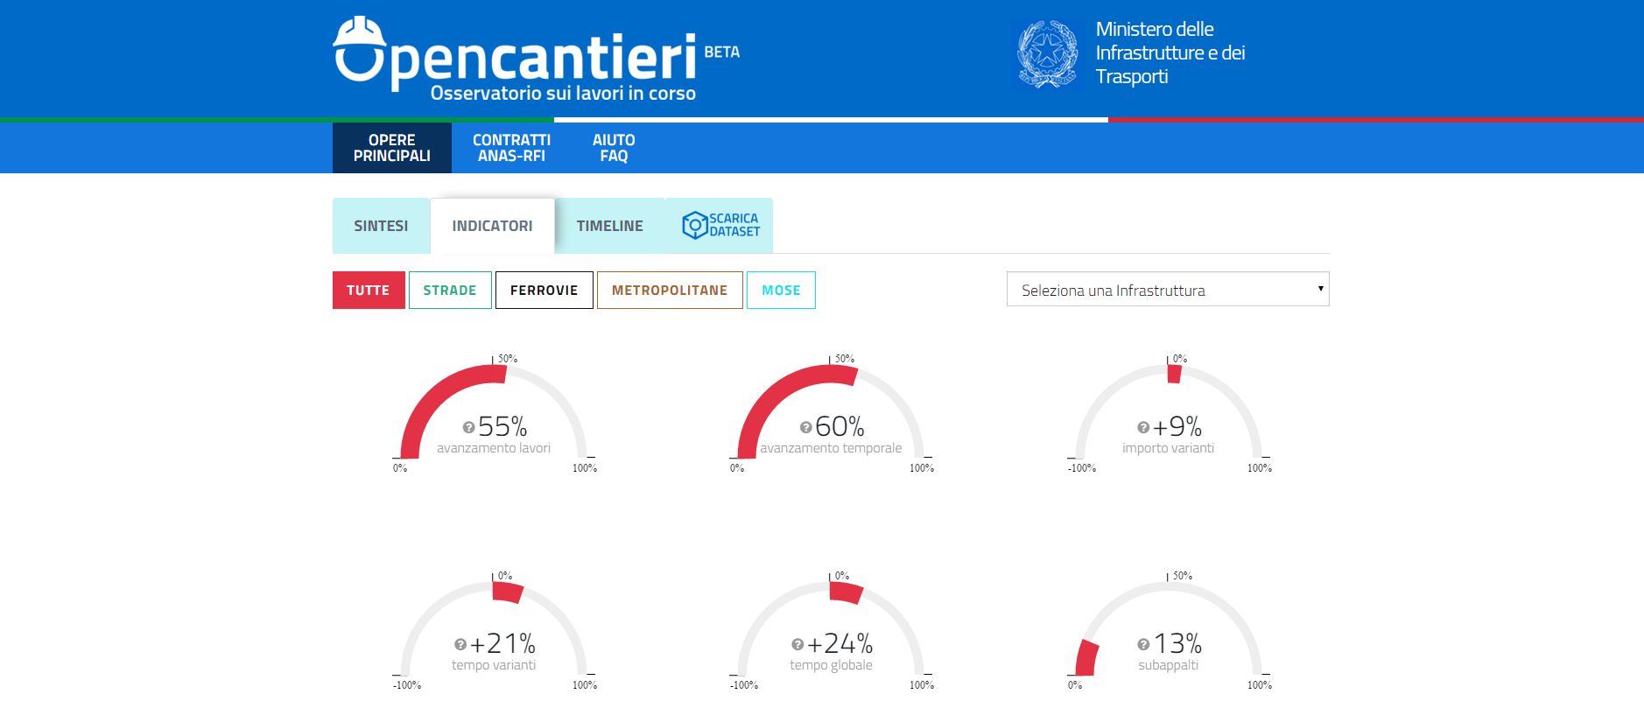
Shedding light on performance of infrastructure projects
Open data initiatives and open contracting promote transparency in infrastructure projects and reinforce trust of citizens
Notes:
The Italian Ministry of Infrastructure and Transport realased on 15 Feb 2016 the Opencantieri platform whereby progress in infrastructure works can be assessed against a number of key performance indicators.

Slide 24


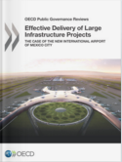

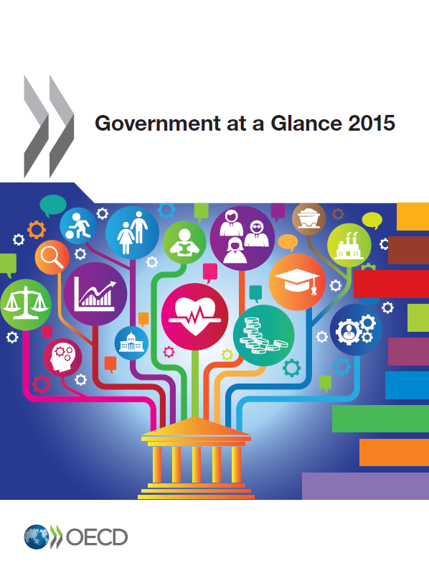
For more information on OECD work on public procurement
http://www.oecd.org/gov/ethics/integrityinpublicprocurement.htm

